Slide 1
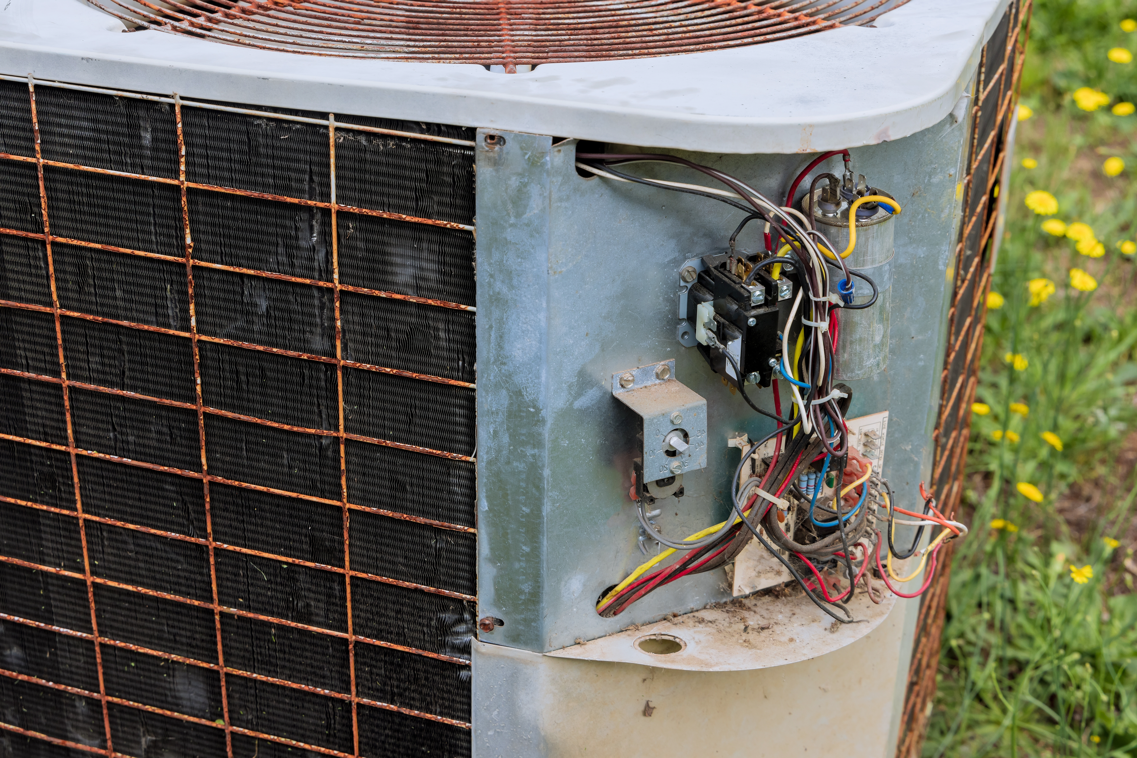
Existing Single Family
Reach Code
Air Conditioner Replacements/Additions
    [Jurisdiction and Date]

Slide 2

Agenda
Objectives and Scope
Background & Policy Context
Proposed Policy Requirements & Exceptions
Development Process and Next Steps
Ways to Provide Feedback
Q&A Discussion
Notes:
Image source: Stock

Slide 3
Objectives and Scope

Slide 4


Ordinance Objectives
Require energy upgrades when replacing or adding a central air conditioner
  Upgrade to an electric heat pump space conditioner (heater) and comply with State Code
    May keep or replace furnace for supplemental heating only.
  Keep gas furnace and make additional energy improvements
Meet Federal and State requirements
  Electric heat pump is not required, but encouraged

Slide 5
Background and Context

Slide 6
Policy Context
Local Policy
Cite CAP (or other policy document) regarding existing buildings
Recite history, other reach codes
State Policy
AC to Heat Pump offered as voluntary measure for local adoption under California Green Buildings Standard Code (CALGreen)
Proposed reach code includes some changes to CALGreen text to facilitate implementation

Slide 7
Context: GHG Emissions Projections 2030 [use local data]
Notes:
Edit with local data

Slide 8
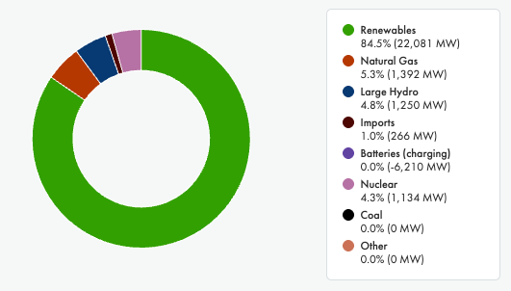
Why Go All-Electric?
Power Supply Mix in CA – An Instantaneous Snapshot
Source: https://www.caiso.com/todays-outlook, May 10, 2025
Notes:
Image source: CAISO

Slide 9
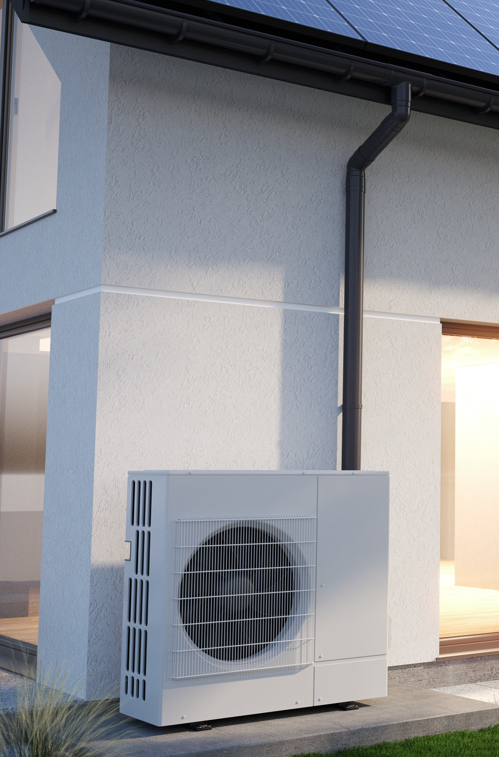
Why Heat Pumps?
Heat pumps result in major greenhouse gas emission reductions
  Two to four times more efficient than gas furnaces
  Powered by electricity, which in California, is mostly from renewable energy sources
Can be both an air conditioner and a space heater
No on-site combustion of gas
No risk of carbon monoxide poisoning from the space conditioning system

Slide 10
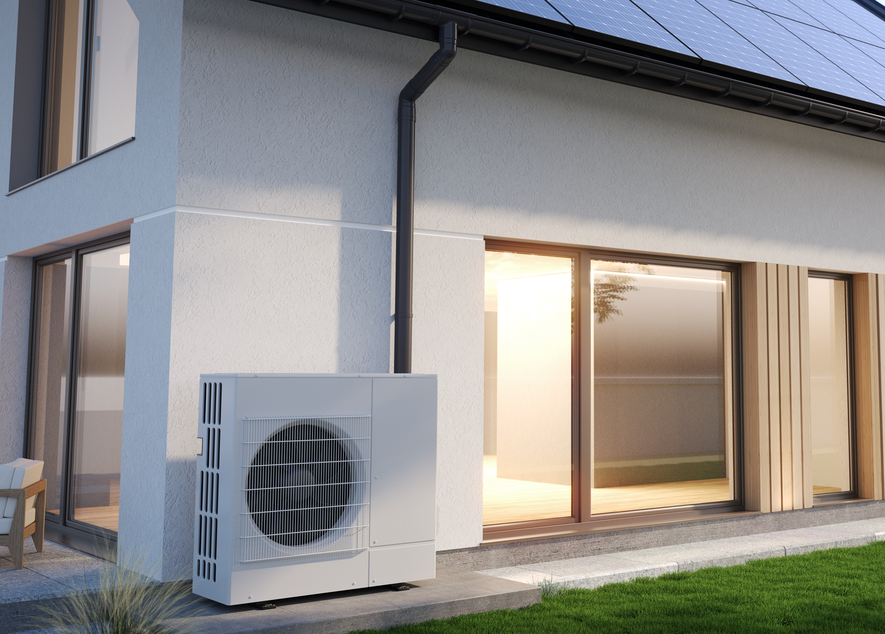
Air Conditioners in Existing [Jurisdiction] Homes
XX existing single family homes, duplexes and townhomes
YY with central air conditioning and gas heating
ZZ annual permits for air conditioner replacements
AA projects affected by proposed requirements

Slide 11
Policy Development Timeline
[Date]
Community Engagement
[Date]
2nd Council
Reading
[Date]
1st Council Reading
[Date]
File with CEC & CBSC
[Date]
Code takes effect
[Date]
[Name of commissions/committees]

Slide 12
Proposed Policy Requirements

Slide 13
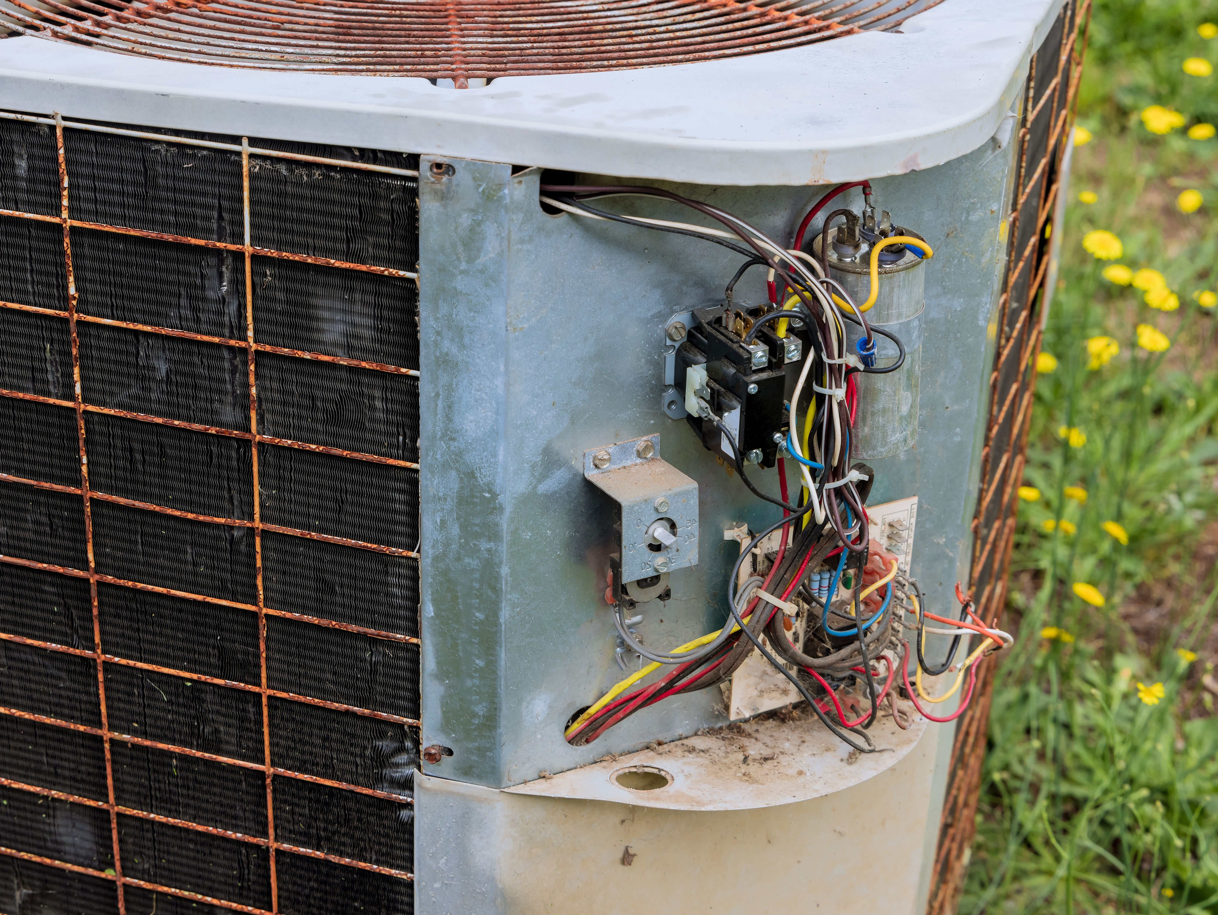
Policy at a Glance:
Existing Single Family Homes, Duplexes and Townhomes
When replacing or adding a central air conditioner, either:
  Install model that functions as a heat pump space heater and meet State code requirements that apply to the project (may keep existing or replace gas furnace for supplemental heating only), OR
  Keep a gas furnace, meet State code requirements that apply to the project AND meet additional local reach code requirements.

Slide 14
New Heat Pump or Air Conditioner Only vs Heat Pump or Air Conditioner and New Ducts
New AC Only
Duct Sealing:
10% or RA Path
New AC/Furnace and
New Ducts
Duct Sealing: 5%
Airflow:
300 CFM/ton or RA Path
Fan Efficacy:
0.45 W/CFM or RA Path
Ref Charge
Attic Insulation: R-49
Exception: Exist R-38
Airflow:
350 CFM/ton
Fan Efficacy:
0.35 W/CFM
Ref Charge
Attic Insulation: R-49
CZ 1-4, 6, 8-16 Only.
Exc. R-19 in CZ 1, 3, 6
Air Sealing: Ceiling
CZ 2, 4, 8-16 Only.
Exception - Exist R-19
New Heat Pump Only
Duct Sealing:
10% or RA Path
Airflow:
300 CFM/ton or RA Path
Fan Efficacy:
No requirement
Ref Charge
Air Sealing: Ceiling
Exception: Exist R-38
New Heat Pump and
New Ducts
Duct Insulation:
R-6 in CZ 3, 5-7
R-8 in CZ 1, 2, 4, 8-16
Airflow:
350 CFM/ton
Fan Efficacy:
0.58 W/CFM
Ref Charge
Attic Insulation: R-49
CZ 1-4, 6, 8-16 Only.
Exc. R-19 in CZ 1, 3, 6
Air Sealing: Ceiling
CZ 2, 4, 8-16 Only.
Exception - Exist R-19
Duct Insulation: R-8
Duct Sealing: 5%
Duct Insulation:
No Requirement
Duct Insulation:
No Requirement
Solid blue:
Reach over state code
Gradient: Reach in some CZ
No fill: Same as state code
RA: Reference Appendix
April 2025, Local Energy Codes Program
Notes:
This chart shows two AC pathways, one with an existing duct system and another path with a new duct system, alongside the heat pump pathways. The figure presents the proposed efficiency upgrade measures that would be part of a reach code (solid blue) along with the relevant requirements from Title 24, Part 6 that are triggered as part of equipment replacements (white or gradient blue). A reach code that establishes requirements when an air conditioner is replaced or installed new could allow for either a heat pump to be installed or an AC as long as the performance measures listed below are met. If installing a heat pump, a homeowner may keep the existing furnace or install a new one, but only for supplemental heating.

Slide 15
Summary of Requirements
Heat Pumps
Ducts | State Code Requirements | Additional Local Code Requirements
Existing | Duct sealing (10% leakage) Airflow efficiency (300 CFM/ton) Refrigerant charge verification | None
New | Duct sealing (5% leakage) Airflow efficiency (350 CFM/ton) Refrigerant charge verification Attic insulation (R-49) [CZs 1-4, 6, 8-16] Air sealing [CZs 2-4, 8-16] | None
Air Conditioners
Ducts | State Code Requirements | Additional Local Code Requirements
Existing | Duct sealing (10% leakage) Airflow efficiency (300 CFM/ton) Refrigerant charge verification [CZs 2, 8-15] | Fan efficacy (0.45 watts/CFM) Attic insulation (R-49) Air sealing Refrigerant charge verification [CZs 1, 3-7, 16]
New | Duct sealing (5% leakage) Airflow efficiency (350 CFM/ton) Refrigerant charge verification [CZs 2, 8-15] R-6 Duct insulation [CZ 3, 5-7] R-8 Duct insulation [CZs 1-2, 4, 8-16] Attic Insulation (R-49) [CZs 1-4, 6, 8-16] Air sealing [CZs 2-4, 8-16] | Refrigerant charge verification [CZs 1, 3-7, 16] Fan efficacy (0.35 watts/CFM) R-8 Duct insulation [CZs 3, 5-7]
Notes:
Modify for climate zone
These tables shows four compliance pathways, two for heat pumps and two for AC only. Once set assumes the existing ducts will remain in place; the other assumes the ducts will be replaced.
Note that there are additional local requirements if a heat pump is not installed, but heat pumps only need to meet state minimums.

Slide 16
Incremental Cost and Savings of Heat Pumps
Assumes Furnace Would Be Replaced Anyway
Assumes Furnace Remains in Place (dual fuel system)
Incremental first cost | $XX,XXX
Lifecycle savings | $YY,YYY
Incremental first cost | $XX,XXX
Lifecycle savings | $YY,YYY
Modify by climate zone using the notes
Notes:
Notes. Populate with data from Tables 12 and 13, respectively (2025 AC to Heat Pump Replacement C/E Study) .
Converting to a heat pump will cost a bit more, depending upon whether the furnace would otherwise need to be replaced anyway. [Most climate zones] But bill savings more than offset the initial costs.
These tables compare the incremental costs and lifecycle savings for HP conversions in 2 different scenarios.
The table on the left assumes that the furnace is relatively new and will be left in place. The incremental cost of the HP consists of a) the increment for an AC with heating capability and b) the full cost of integrating the new HP with the air handler in the existing furnace.
In the table on the right, it is assumed that the homeowner would need to replace the furnace at around the same time anyway so the incremental cost is limited to the increment for an AC with heating capability.

Slide 17
GHG Reductions
Approach | Metric Tons |  |  | Percentage
Vintage | Pre- 1978 | 1978- 1991 | 1992- 2010 | Pre- 1978 | 1978- 1991 | 1992- 2010
Heat pump with furnace as backup |  |  |  | % | % | %
Heat pump & new air handler (no furnace) |  |  |  | % | % | %
Populate using data from model staff report

Slide 18

General Exceptions
Where the capacity of the existing main electrical service panel is insufficient to supply the electrical capacity of a heat pump sized to meet the heating load
Where the required capacity of a heat pump is 12,000 Btu/hr more than the air conditioner capacity

Slide 19
Specific Exceptions
R-49 attic insulation and air sealing for projects using existing ducts and no heat pump
  Not required if attic is already insulated to R-38
All other exceptions in the State code apply
Notes:
R-38 exception exists under prescriptive requirement for attic insulation in alterations under the state code, 150.2(b)1J.

Slide 20
Resources for Homeowners
Inflation Reduction Act Residential Energy Rebate Programs
Home Electrification and Appliance Rebates (HEEHRA): rebates for qualifying, energy saving appliances and equipment to income-eligible, single-family households and multifamily properties
Equitable Building Decarbonization Direct Install Program: no-cost energy retrofits for low-income households
Pay for Performance Program: rebates for whole home energy retrofits for Californians regardless of household income
Federal tax credits are available for most residential energy upgrades (approximately 30% for each improvement, with caps per measure and total in a given tax year)
Federal activities have created uncertainties for many programs. Check current status and requirements.
Notes:
https://www.energy.ca.gov/programs-and-topics/programs/inflation-reduction-act-residential-energy-rebate-programs
https://www.energystar.gov/about/federal-tax-credits
Add any local/regional incentives

Slide 21
Ways to Provide Feedback

Slide 22

Stakeholder and Community Engagement
[Provide details on outreach and engagement activities]

Slide 23
Q & A Discussion

Slide 24
Thank you!
  We appreciate your time
  Name
    email
  Name
    email
url

