Slide 1
Instructions for Staff
Version 1.0, June 2025
This is a generic slide deck intended to support staff in presentations to stakeholders, council, or board of supervisors
Customize for your jurisdiction, audience and stage of development
[Text in blue italics in brackets] are instructions and should be removed
Use Cost Effectiveness Explorer to develop scope
Access support materials at localenergycodes.com
Contact Local Energy Codes for assistance
Notes:
6-23-2025

Slide 2
Resources for Staff
Visit LocalEnergyCodes.com or Bay Area Reach Codes to download the latest version of the resources (as they become available)
  This slide deck
  Model ordinance
  Cost effectiveness study
  Cost Effectiveness Explorer
  Process and Decision Guide
  FAQs
  List of jurisdictions that have adopted a similar ordinance
  Application checklist
  Exception form
  Filing checklist
  Submission instructions

Slide 3
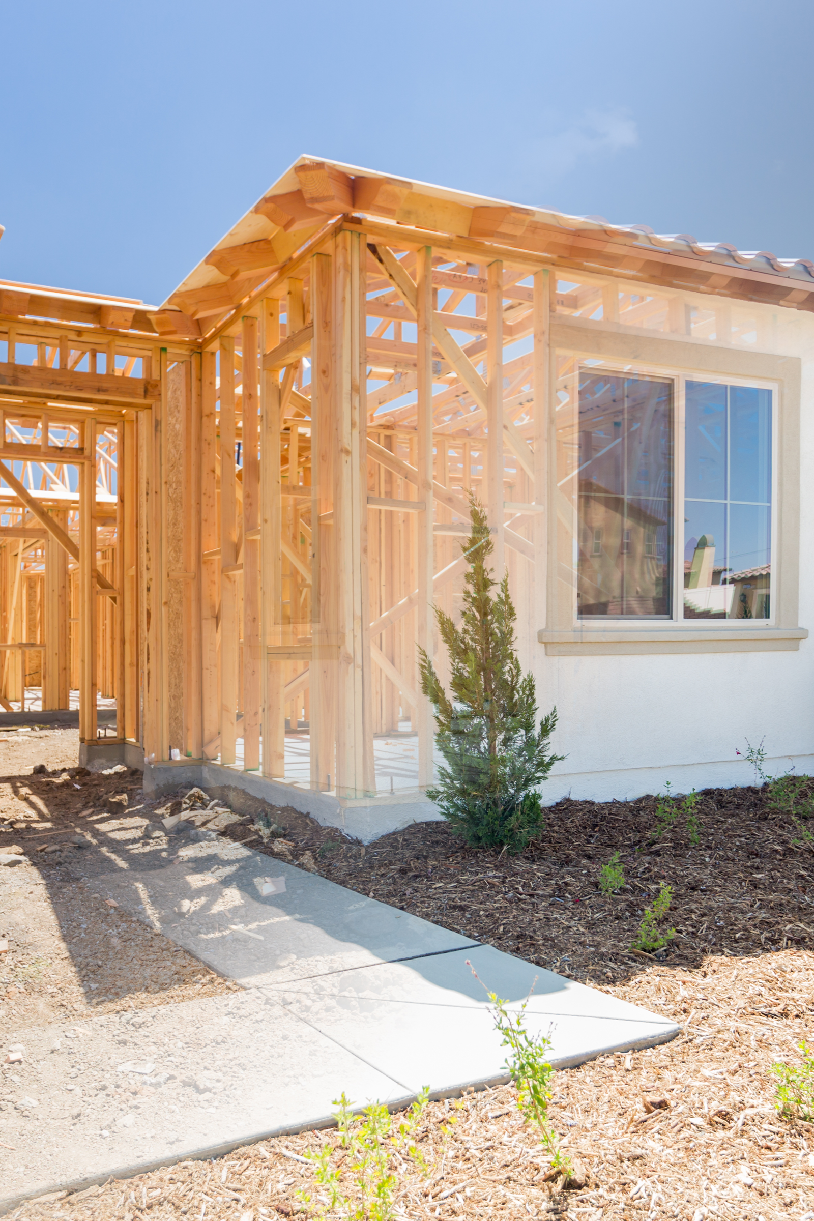
Existing Single Family
Reach Code
Flexible Path (FlexPath) Compliance, Electric Readiness and Cool Roofs
    [Jurisdiction and Date]

Slide 4

Agenda
Objectives and Scope
Background & Policy Context
Proposed Policy Requirements & Exceptions
Development Process and Next Steps
Ways to Provide Feedback
Q&A Discussion
Notes:
Image source: Stock

Slide 5
Objectives and Scope

Slide 6


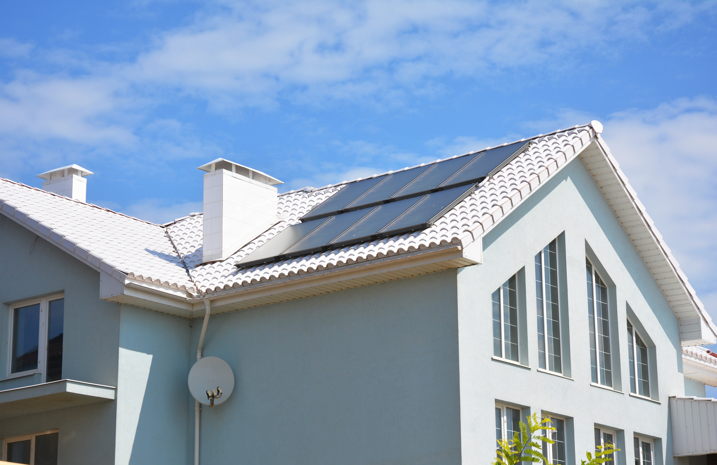
Scope
Single Family Homes, Duplexes and Townhomes
FlexPath. During remodels of a certain size and scope, install energy improvements from among a menu of options
Electric Readiness. During alterations to kitchens, laundry areas, and utility rooms, pre-wire for electric appliances
Cool Roof. Upon reroofing, upgrade to a cool roof.
Electric appliances are NOT required, only encouraged

Slide 7


Ordinance Objectives
Capture GHG reductions during certain projects through:
  Electrification
  Energy efficiency
  Solar PV
Prepare homes for future electrification
Provide flexibility for applicants
Use a simple application process
Meet Federal and State requirements

Slide 8
Background and Context

Slide 9
Who has adopted?
Electric Readiness | FlexPath
Atherton | Carlsbad
Fairfax | Corte Madera
Mountain View | Encinitas
Portola Valley | Fairfax
San Anselmo | Marin County
San Luis Obispo | Piedmont
San Mateo | San Anselmo
 | Santa Cruz
 | San Luis Obispo
 | San Rafael
A list of adopted ordinances is available on the LocalEnergyCodes.com web site

Slide 10
Local Policy Context
Cite CAP (or other policy document) regarding existing buildings
Recite history, other reach codes

Slide 11
Context: GHG Emissions Projections 2030 [use local data]
Notes:
Edit with local data

Slide 12
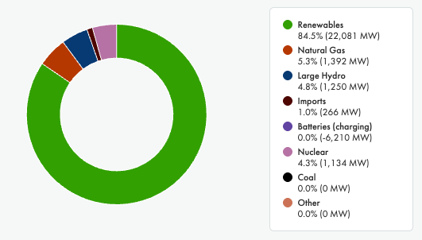
Why Go All-Electric?
Power Supply Mix in CA – A Snapshot
Source: https://www.caiso.com/todays-outlook/supply, May 10, 2025
Notes:
Image source: CAISO

Slide 13
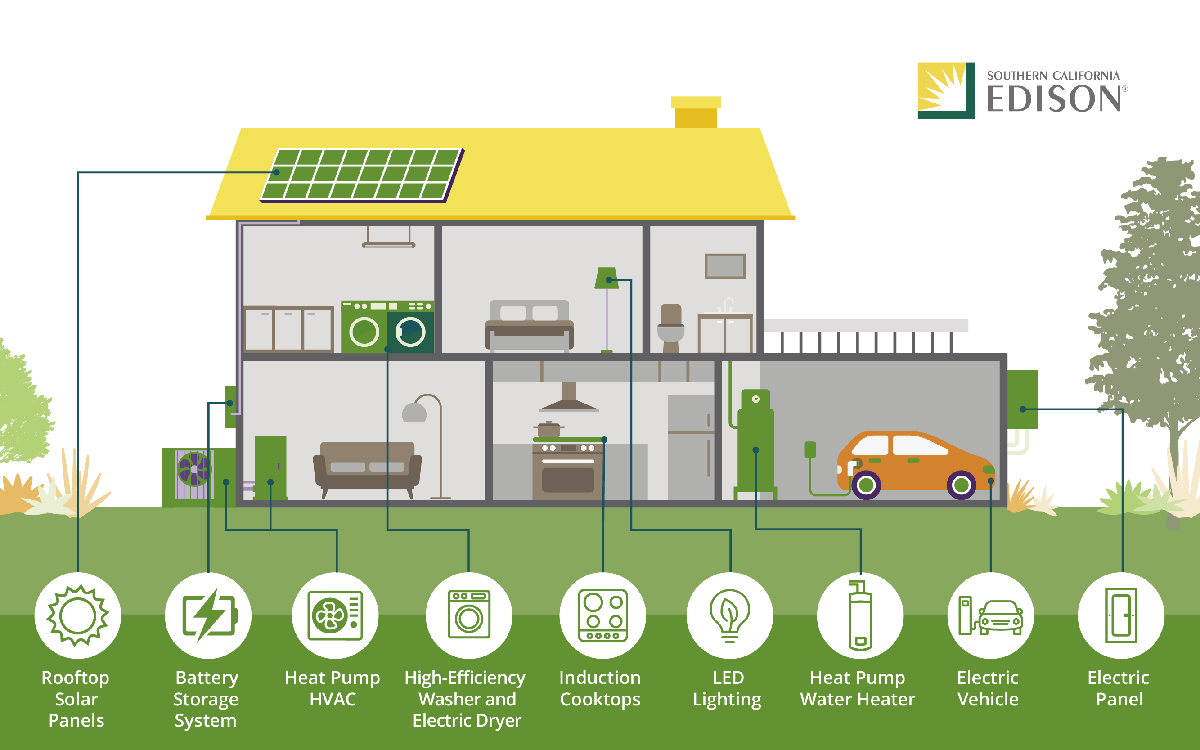
Today’s All-Electric Home
Source: https://energized.edison.com/stories/all-electric-buildings-clean-energys-next-frontier#:~:text=California's%20new%20building%20code%20%2D%20Opens,live%20healthier%20and%20lower%20emissions
Notes:
https://energized.edison.com/stories/all-electric-buildings-clean-energys-next-frontier#:~:text=California's%20new%20building%20code%20%2D%20Opens,live%20healthier%20and%20lower%20emissions.

Slide 14
When are building energy decisions made?
When they are built
When something breaks
When a building is undergoing a major addition or alteration

Slide 15

Building Stock and Trends
Residential Project Data
XX existing single family homes, duplexes and townhomes
YY annual permits
ZZ annual additions and alterations that are related to ADU conversions
AA projects affected by proposed requirements
Notes:
Image: Stock Powerpoint

Slide 16
Policy Development Timeline
[Date]
Community Engagement
[Date]
2nd Council
Reading
[Date]
1st Council Reading
[Date]
File with CEC & CBSC
[Date]
Code takes effect
[Date]
[Name of commissions and/or committees]

Slide 17
Proposed Policy Requirements

Slide 18
Requirements at a Glance
FlexPath | Electric | Readiness | Cool Roofs
Substantial addition or alteration | Alteration to kitchen, laundry area, utility room | Electric panel upgrade | Re-roof (50% or more)
Install measures from menu of options | Make home electric ready | Deploy load management and/or efficiency first | Install a cool roof

Slide 19
Available Measures [edit as needed]
Heat Pump Appliances
Water Heater
Space Conditioning
Clothes Dryer
Roof Improvements
Cool Roof
Radiant Barrier
Other Electrification
Induction Cooktop
All-electric Home
Envelope Improvements
Air Sealing
Attic Insulation
Wall Insulation
Windows
Raised Floor Insulation
Duct Improvements
Duct Sealing
New Ducts + Insulation + sealing
Other Efficiency
Solar PV
Electric Readiness
Lighting
Water Heating Package

Slide 20
Co-Benefits of Measures
Category | Examples | Benefits
Efficiency Measures | Windows Insulation Air sealing Duct sealing | Increased comfort More consistent temperature Reduced noise Fewer pests
Electrification Measures | Heat pump water heater Heat pump space conditioner Induction cooktop Heat pump clothes dryer | Decreased indoor air pollution Reduced asthma risk Reduced carbon monoxide risk Reduce accidental fire risk Heating and cooling capability
Solar PV | Solar PV panels | Energy security/reliability Quiet and unobtrusive Little maintenance required
Electric Readiness | Prewiring | CA Air Resources Board readiness Reduce cost and time of future work needed by completing at a convenient time
Cool roof | Highly reflective/light-colored materials | Cooler indoor temperature Decreased urban heat island effect Extended roof lifetime

Slide 21
Proposed Policy Requirements: FlexPath

Slide 22
FlexPath – Flexible Compliance Pathway
Proposed requirements for major residential addition and/or alteration projects to include energy efficiency measures
  What is a “major” addition or alteration as proposed?
  [insert local definition]
  What would a project applicant have to do?
    Pick from a menu of energy efficiency measures
  Would this apply to small projects, appliance replacements, window projects, cosmetic changes, work that doesn’t require a permit?
    No, no, no, no, and no

Slide 23
Example
[insert details of a hypothetical project that meets the FlexPath trigger]
Scope:
Valuation:

Slide 24
Measures & Measure Points
Measure | Points
Lighting Measures | Mandatory
Water Heating Package | Mandatory
New ducts, R-8 insulation + duct sealing | 8
R-30 Raised Floor Insulation | 7
Windows | 6
Duct sealing | 5
R-49 Attic insulation | 4
Air sealing | 1
Cool roof | 1
High eff. heat pump space conditioning system | 18
Heat pump space conditioning system | 17
Solar PV or Solar PV + electric readiness | 16
High eff. heat pump water heater replacing gas | 13
Heat pump water heater replacing gas | 12
High eff. heat pump water heater replacing electric | 5
Heat pump water heater replacing electric | 4
Induction Cooktop | 1
Heat Pump Clothes Dryer | 1
[Update chart based on local study results and policy]
Install any number of measures from the table that add up to a total score of X or greater
Complete all mandatory requirements
Notes:
Note that points are based on energy savings.

Slide 25
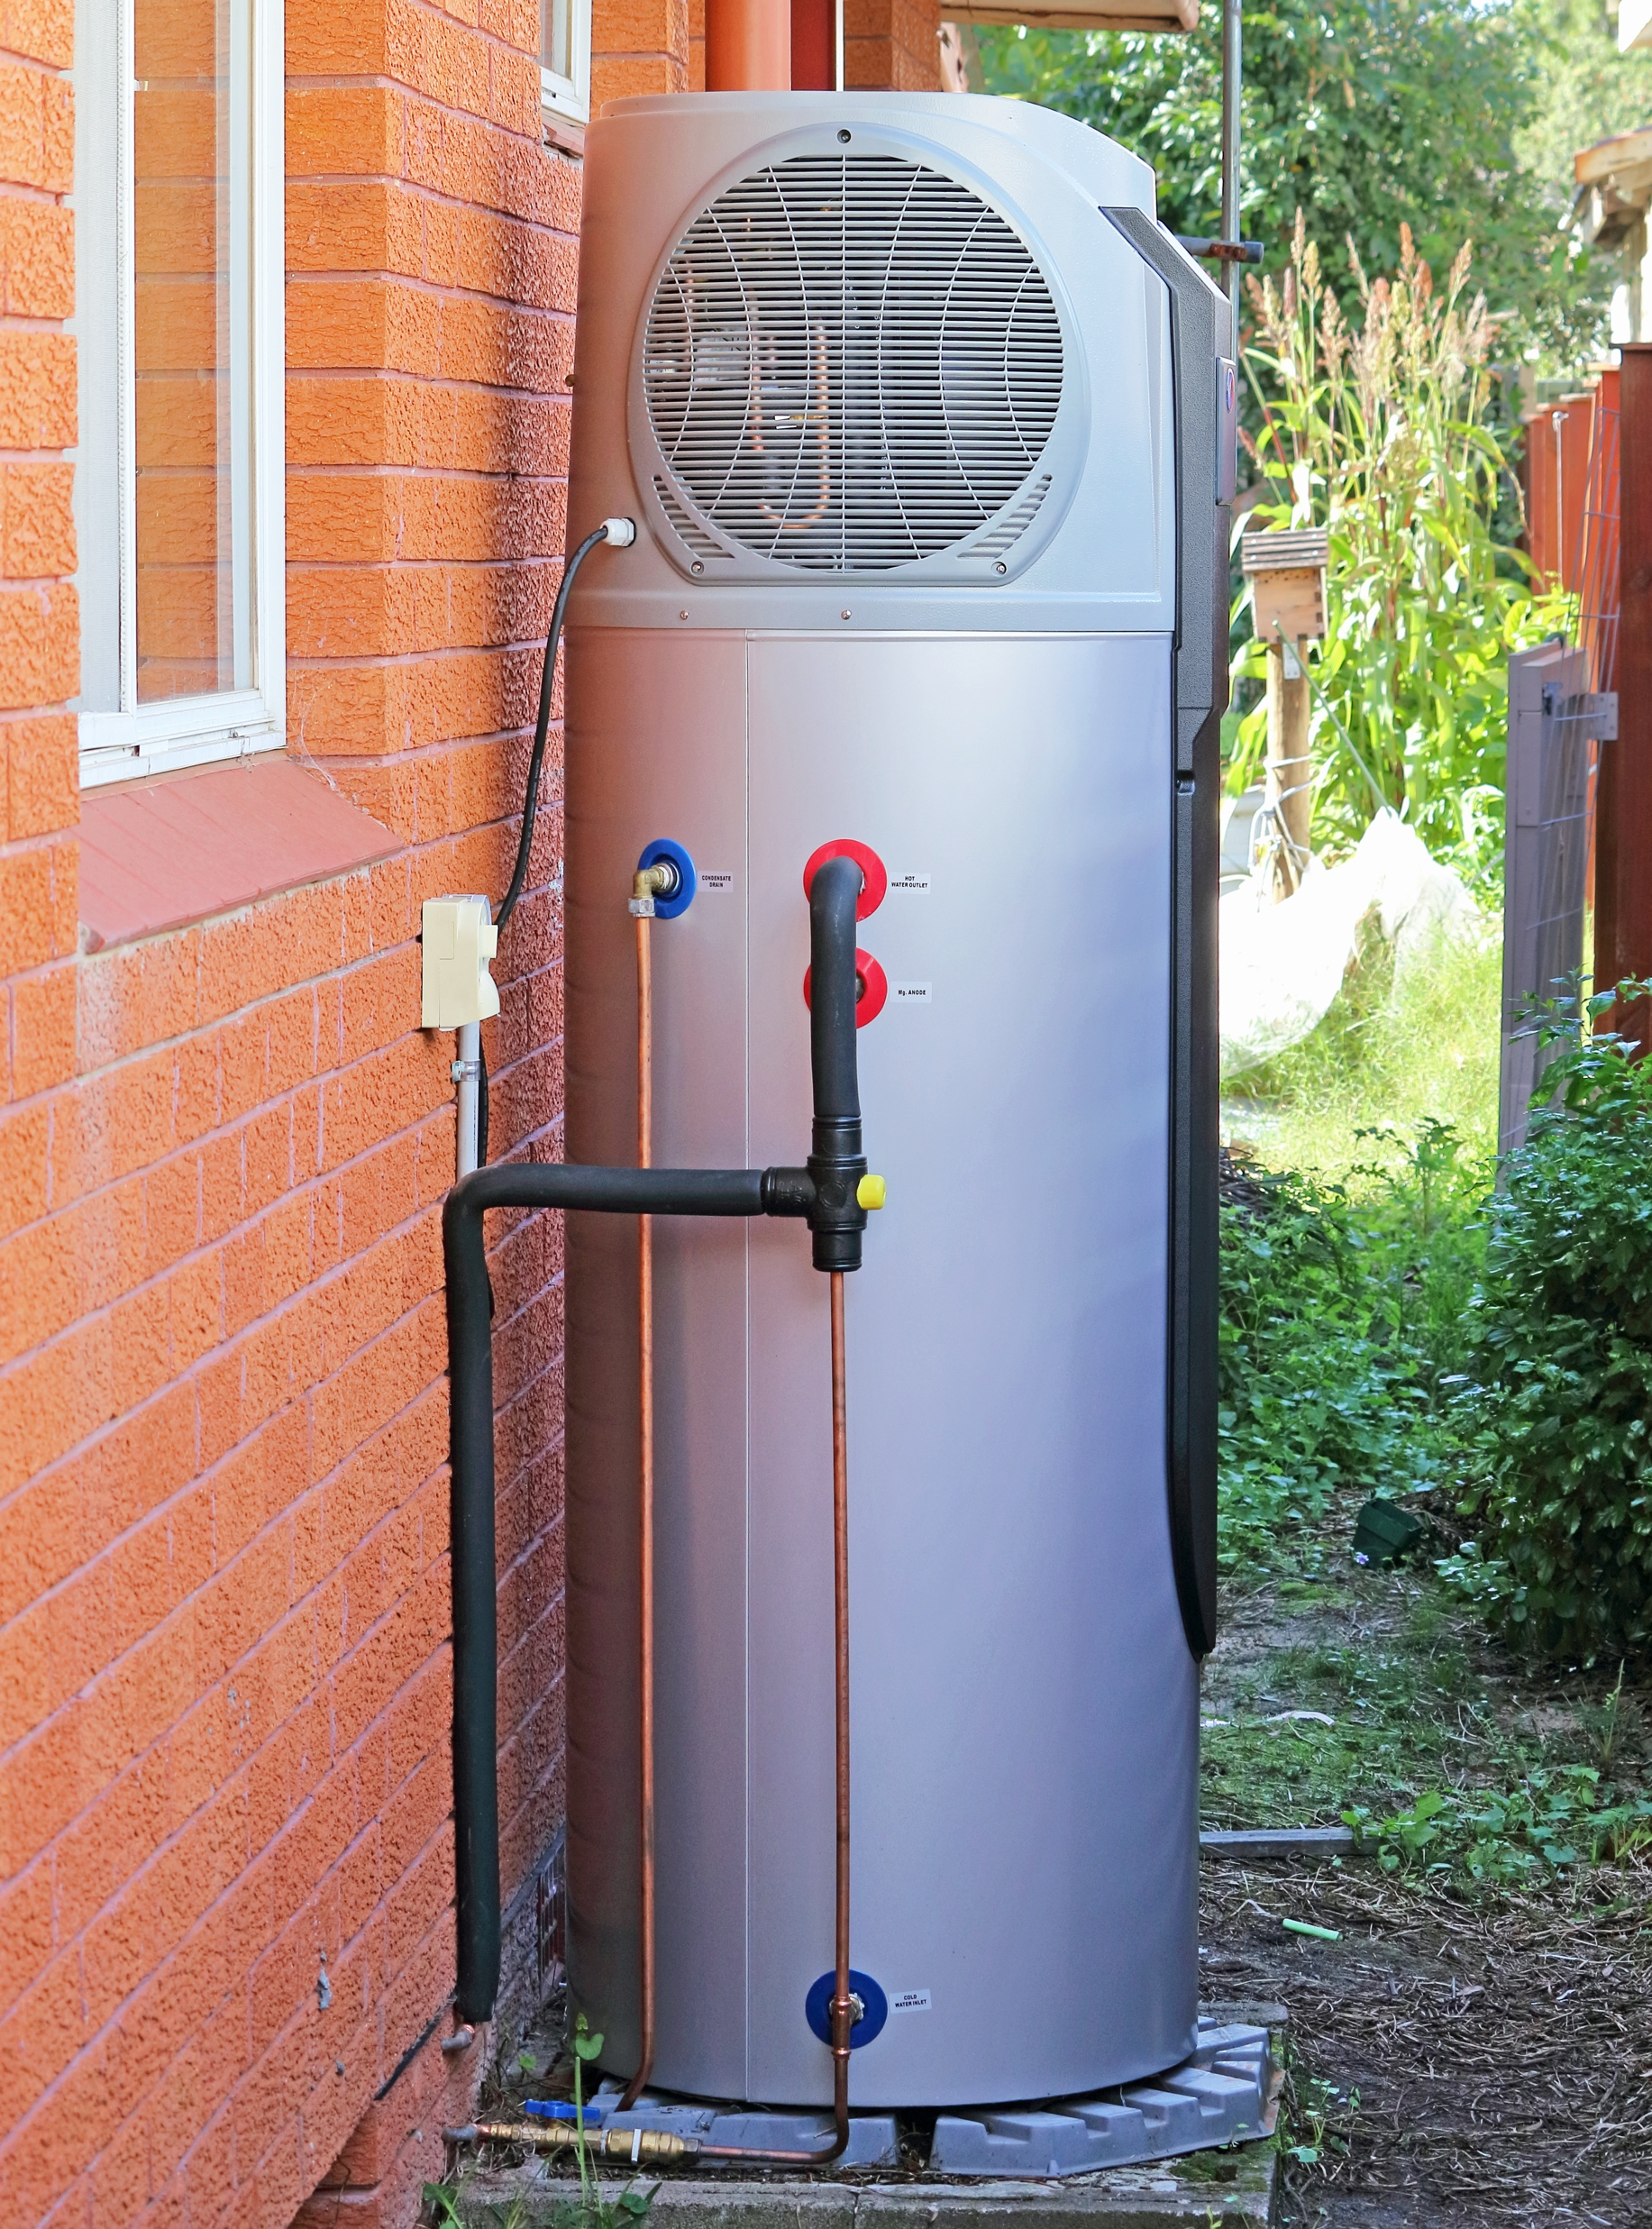
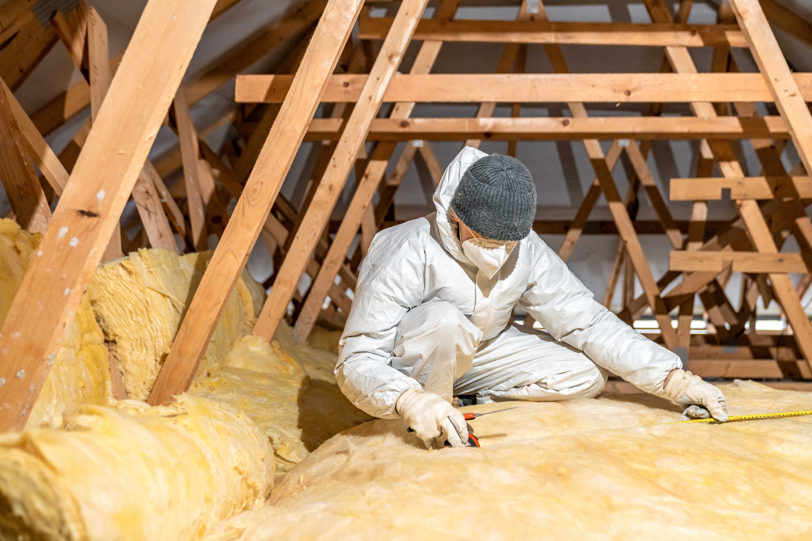
Compliance Options
Efficiency
Electrification
  [list measures used for compliance]
  Compliance cost [$X]
  Compliance cost [Y%] of project cost
  GHG reduction [Y] tons
  [list measures used for compliance]
  Compliance cost [$X]
  Compliance cost [Y%] of project cost
  GHG reduction [Y] tons

Slide 26
Electric Readiness for Solar PV FlexPath Credit
To claim credit for an [a new or] existing PV system, include at least [insert requirement from ordinance] electric readiness measures
Electric range
Heap pump dryer
Heat pump water heater
Heat pump space conditioner
Battery storage
All-electric plan
Notes:
This is an optional requirement that could apply as an additional measure to claim credit for an existing PV system or to claim credit for new PV installations as well. Note, it may require additional work in areas of the house that are not part of the project scope.
Image: Adobe Stock, TRC license

Slide 27
Exceptions
Mobile home, manufactured housing
Emergency Housing
Roofing and window work
Electrification
New, attached ADU
Pre-existing measures
Technical or economic infeasibility
Economic hardship
HOA restrictions
Historic structure restrictions
Repairs
Seismic or medical need

Slide 28

Exceptions: FlexPath
[edit as needed]
Additions or alterations to create a new attached ADU
Mobile home, manufactured housing
Emergency housing
Alterations consisting of roofing and/or windows only
Technical/economic infeasibility
Economic hardship
Preexisting measures
HOA restrictions
Repairs
Projects consisting of electrification measures only
Seismic/medical necessity
Historic structures

Slide 29
Proposed Policy Requirements:
Electric Readiness

Slide 30

Electric Readiness: Kitchens
Trigger: Electrical permit scope includes circuits or receptacles in the kitchen
Install 120 volt receptacle that is upgradable to 240 volts

Slide 31
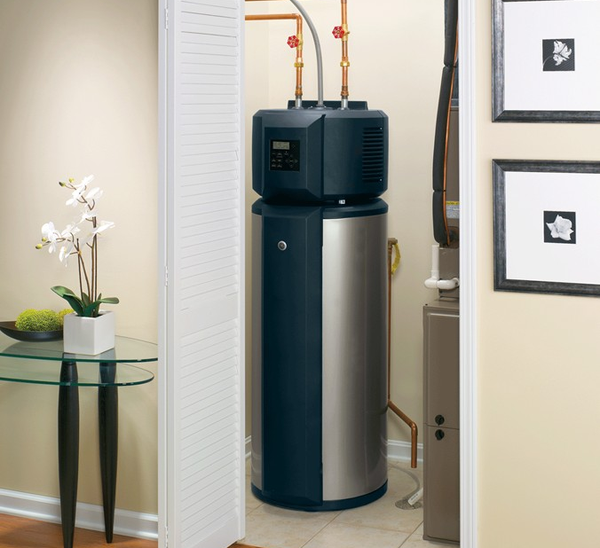
Electric Readiness for Water Heaters
Trigger #1: Wall framing is removed or replaced within 3’ of a gas water heater
Provide space suitable for future heat pump water heater (2.5’ x 2.5’ x 7’) + condensate drain
Trigger #2: Electrical permit scope includes circuits or receptacles within 3’ of existing water heater or 10’ of a future HPWH location above
Install 120 volt receptacle that is upgradable to 240 volts

Slide 32
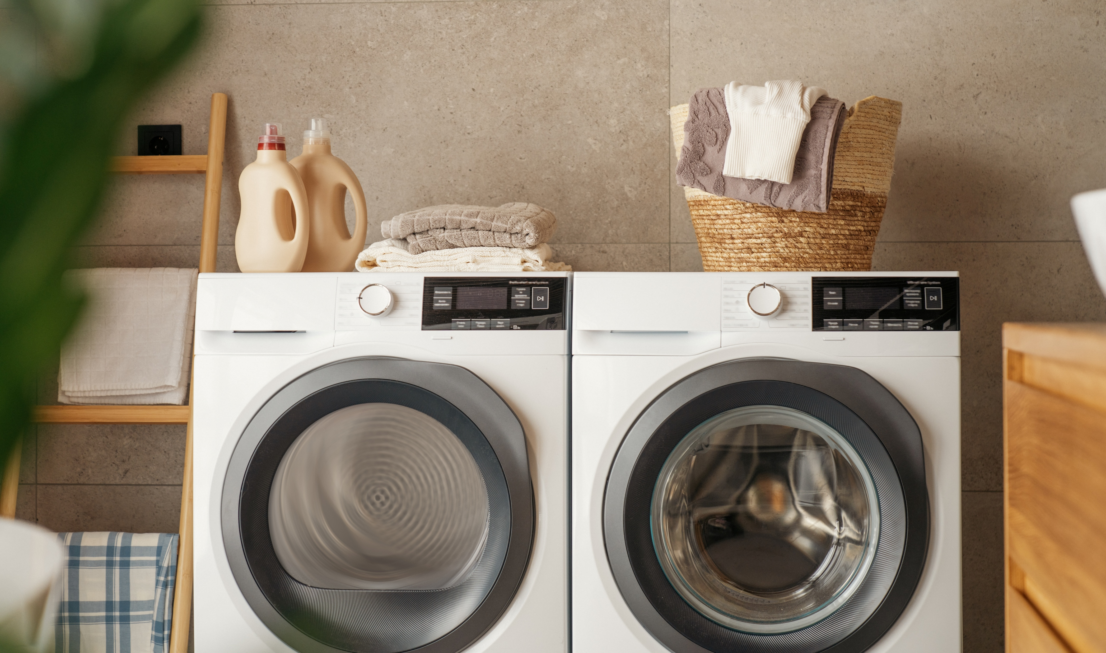
Electric Readiness for Dryers
Trigger: Electrical permit scope includes circuits or receptacles within 3’ of a gas clothes dryer
Install 120 volt receptacle that is upgradable to 240 volts

Slide 33
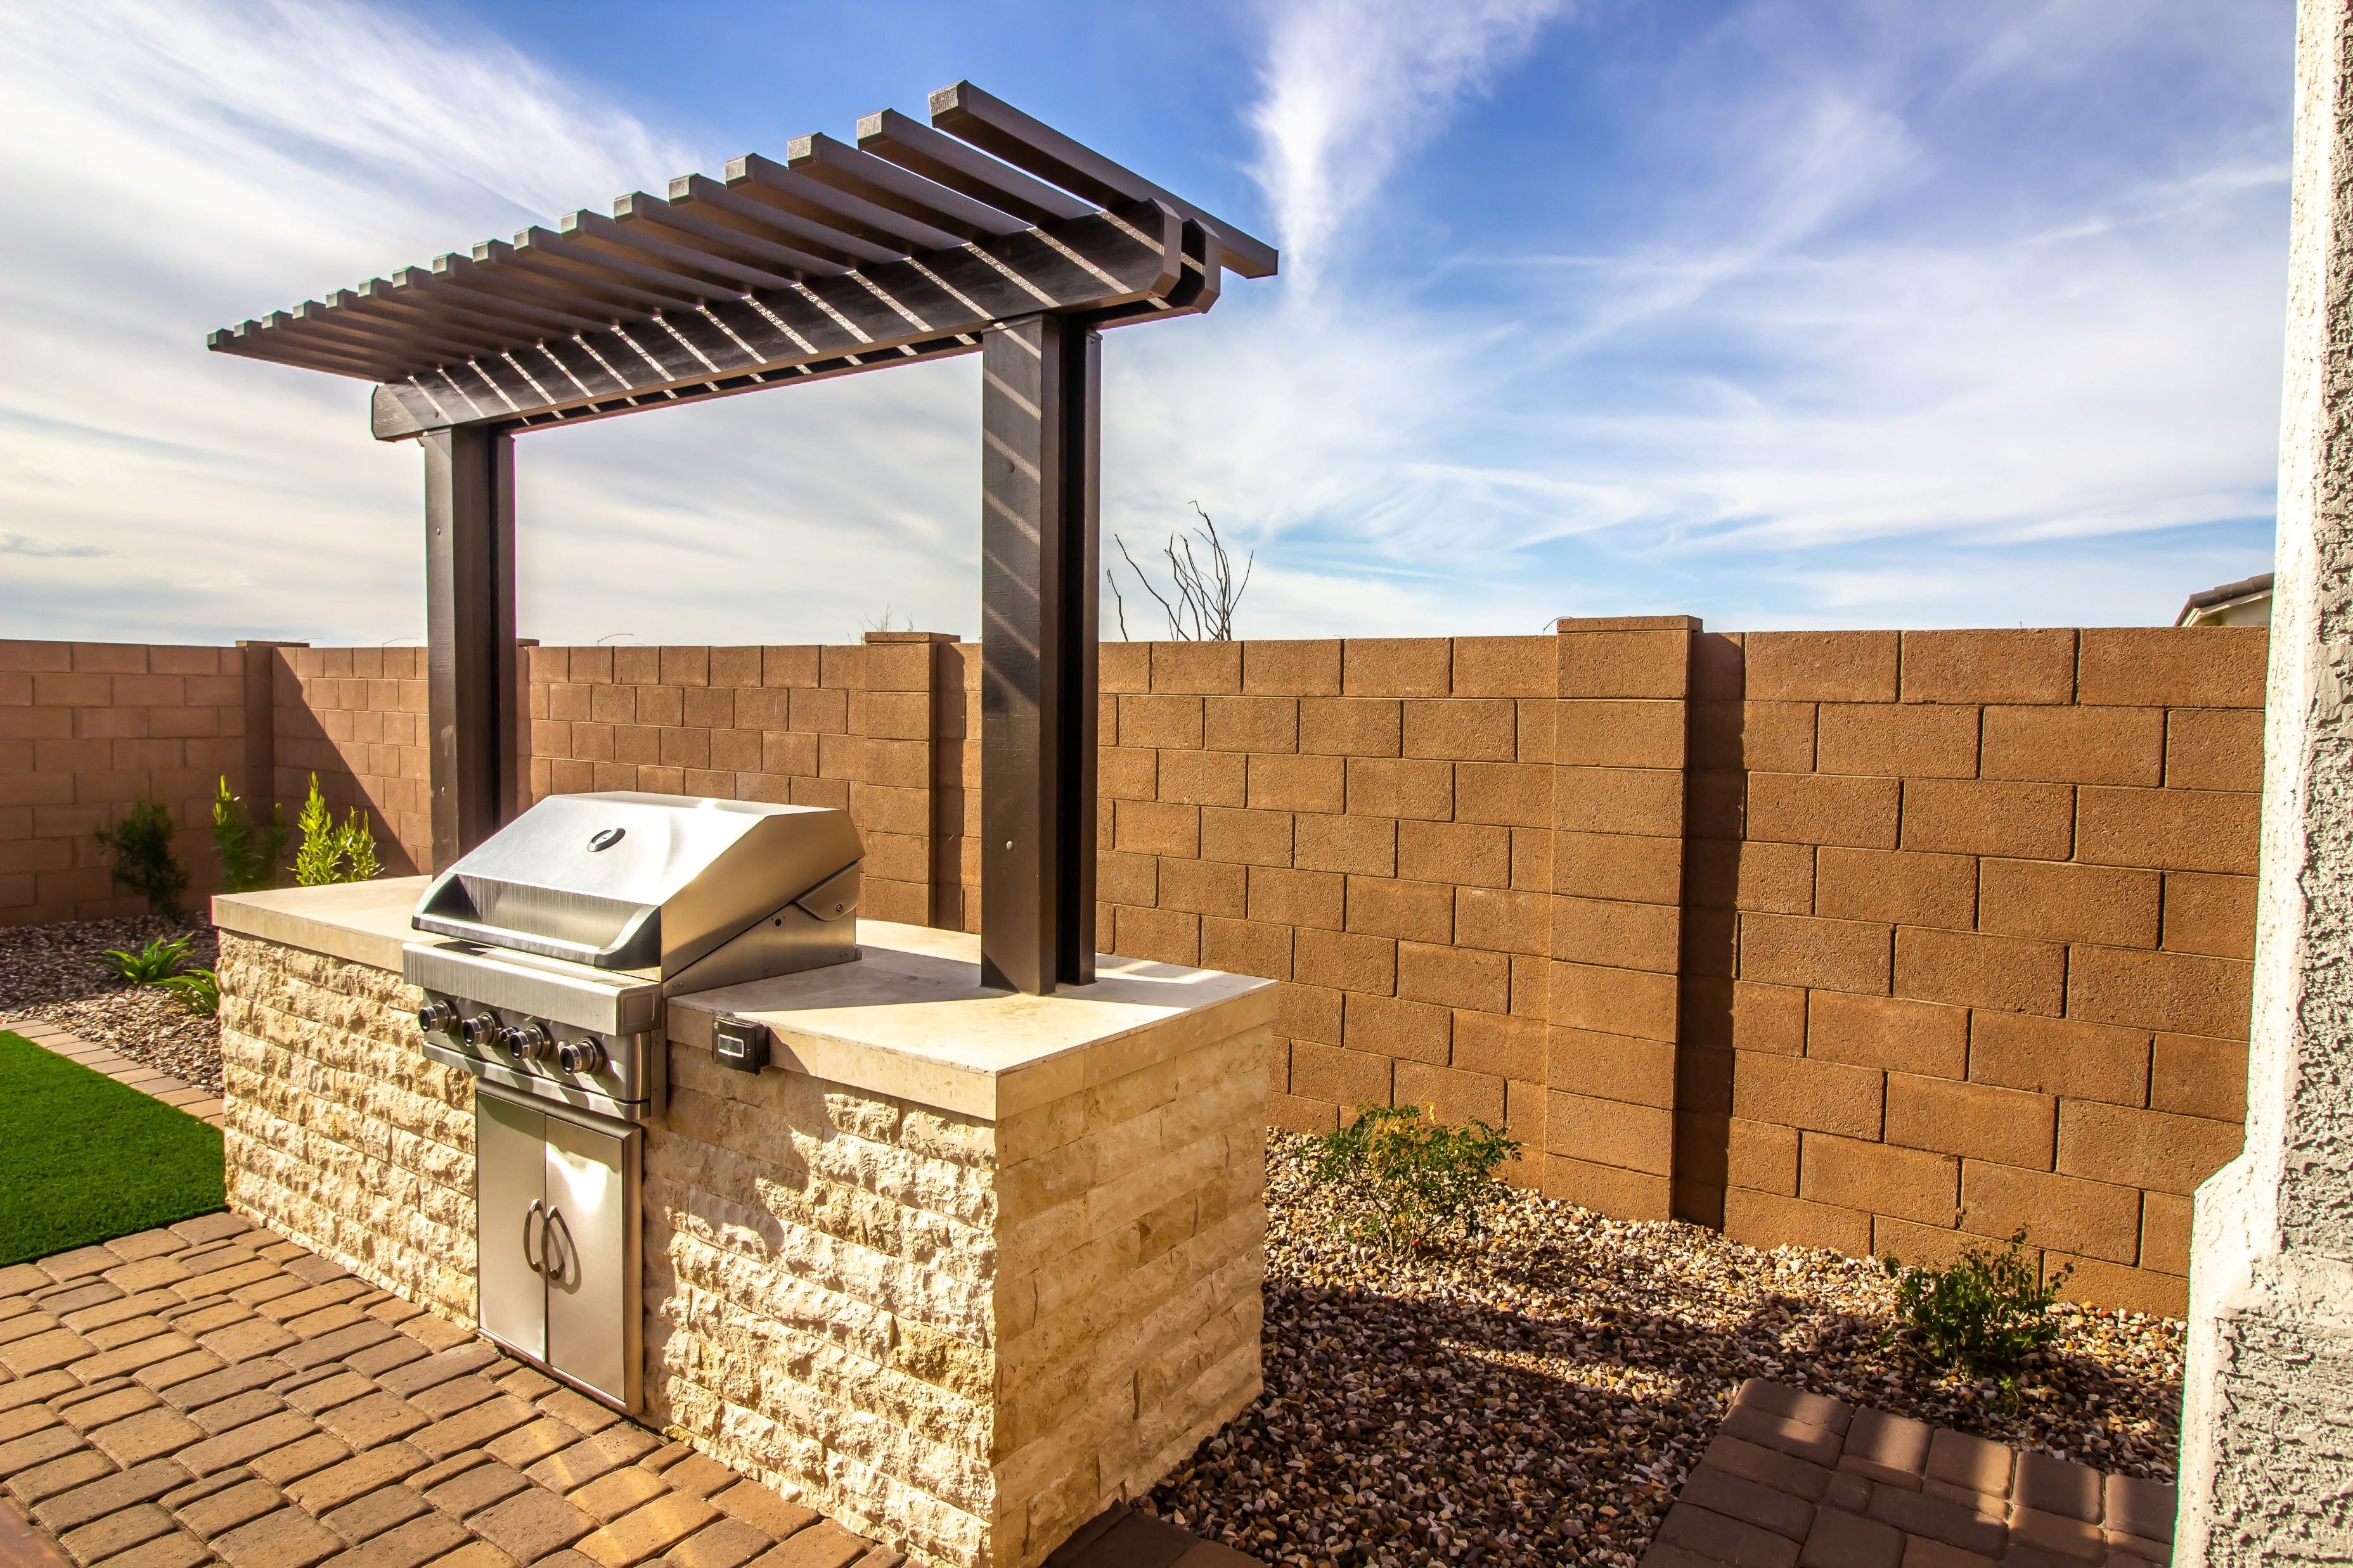
Electric Readiness for Outdoor Appliances
Trigger: When a gas line is extended to outdoor appliances (pools, spas, fireplaces, BBQ)
Designate space for an equivalent electric appliance
Install electrical conduit to serve a future electric appliance

Slide 34
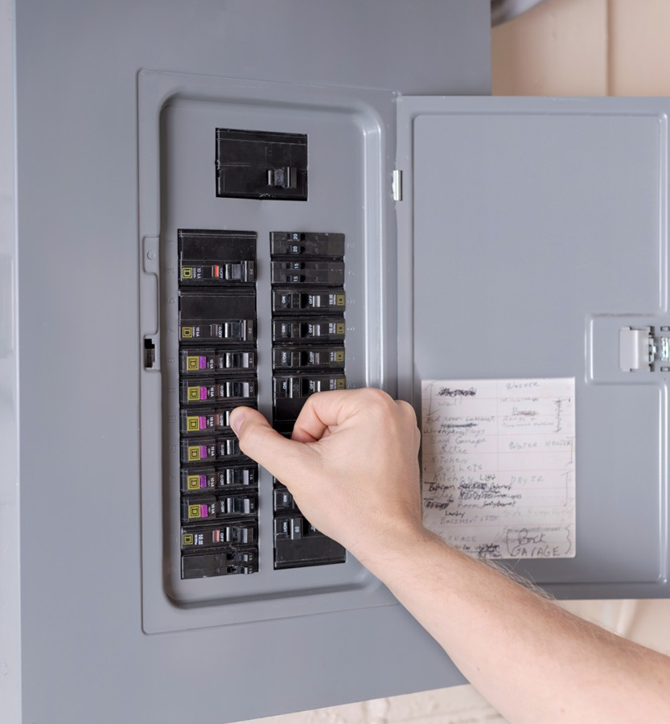
Prerequisites for Electric Panel Upgrades
Requirements
Calculate electrical panel size according to both 220.83 and 220.87 of the Electrical Code
At least one power management or circuit controlling device
Water heater
Clothes dryer
Range
EV Charger
or
At least one 120-volt electric appliance
Water heater
Clothes dryer
Range
or
Circuit control between whole home load and EV charger
Rationale
Contractors may not consider both electrical code calculation options
Panel upgrades are often unnecessary and expensive
Alternatives can reduce cost of electrification and reduce coincident peak load

Slide 35
Exceptions:
Electric Readiness
[edit as needed]
No electrical permit otherwise required for the project
Reach measures trigger electrical service upgrades
Repairs, safety improvements
Projects that would not otherwise require an electrical permit
Additions or alterations to create a new attached ADU
Mobile homes, manufactured housing

Slide 36
Proposed Policy Requirements: Cool Roofs

Slide 37
Cool Roof
If replacing or roofing over an existing roof use an advanced cool roof product
  Minimum aged solar reflectance of 0.25
  Minimum thermal emittance of 0.75, or a minimum SRI of 16
  Applies to steep-sloped roofs only (flat roofs already have higher requirements)

Slide 38
Resources for Homeowners
Inflation Reduction Act Residential Energy Rebate Programs
Home Electrification and Appliance Rebates (HEEHRA): rebates for qualifying, energy saving appliances and equipment to income-eligible, single-family households and multifamily properties
Equitable Building Decarbonization Direct Install Program: no-cost energy retrofits for low-income households
Pay for Performance Program: rebates for whole home energy retrofits for Californians regardless of household income
Federal tax credits are available for most residential energy upgrades (approximately 30% for each improvement, with caps per measure and total in a given tax year)

Slide 39
What this policy would not do
  The policy is not:
    Regulating the use of gas cooking equipment or other kitchen equipment or appliances
    Requiring electrification
    Triggered by small projects like flooring, window replacements, etc.
    Triggered by work that doesn’t require a permit
    Triggered by single appliance replacements
  The policy does consider:
    Special onsite challenges or circumstances

Slide 40
Ways to Provide Feedback

Slide 41

Stakeholder and Community Engagement
[Provide details on outreach and engagement activities]

Slide 42
Q & A Discussion

Slide 43
Thank you!
  We appreciate your time
  Name
    email
  Name
    email
url

